Slide 1
NDArray

Slide 2
NDArray
NDArray是存储和变换数据的主要工具
NDArray提供GPU计算和自动求梯度等更多功能，这些使NDArray更加适合深度学习
0-d (元素)
1-d (向量)
2-d (矩阵)
1.0
[1.0, 2.7, 3.4]
[[1.0, 2.7, 3.4]
[5.0, 0.2, 4.6]
[4.3, 8.5, 0.2]]
一个类标签
一个特征向量
一个特征矩阵

Slide 3
NDArray
3-d
4-d
5-d
[[[[. . .
. . .
. . .]]]
[[[0.1, 2.7, 3.4]
[5.0, 0.2, 4.6]
[4.3, 8.5, 0.2]]
[[3.2, 5.7, 3.4]
[5.4, 6.2, 3.2]
[4.1, 3.5, 6.2]]]
[[[[. . .
. . .
. . .]]]
一张RGB图像
(长 x 宽 x 高)
一组RGB图像
(批量大小 x 长 x 宽 x 高)
一组RGB视频
(批量大小 x 时间
x 长 x 宽 x 高)

Slide 4
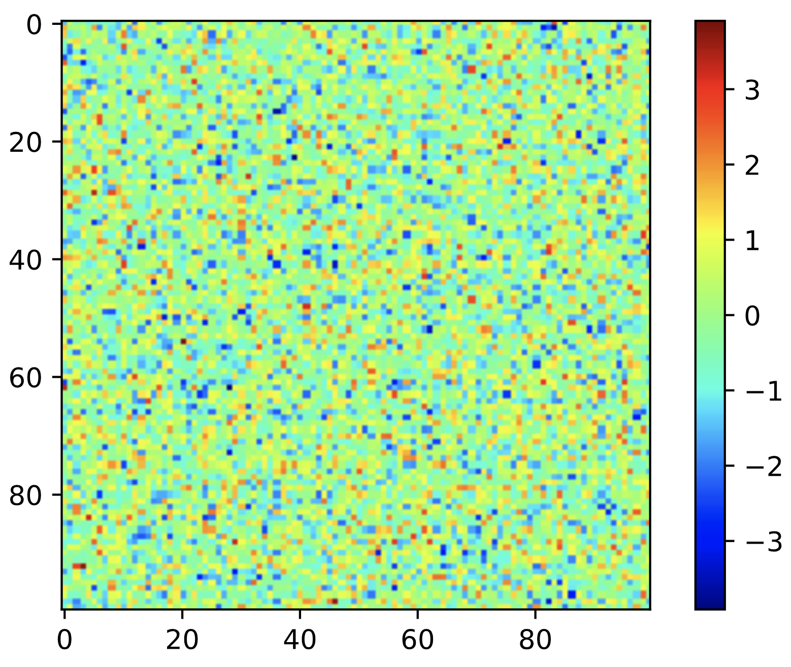
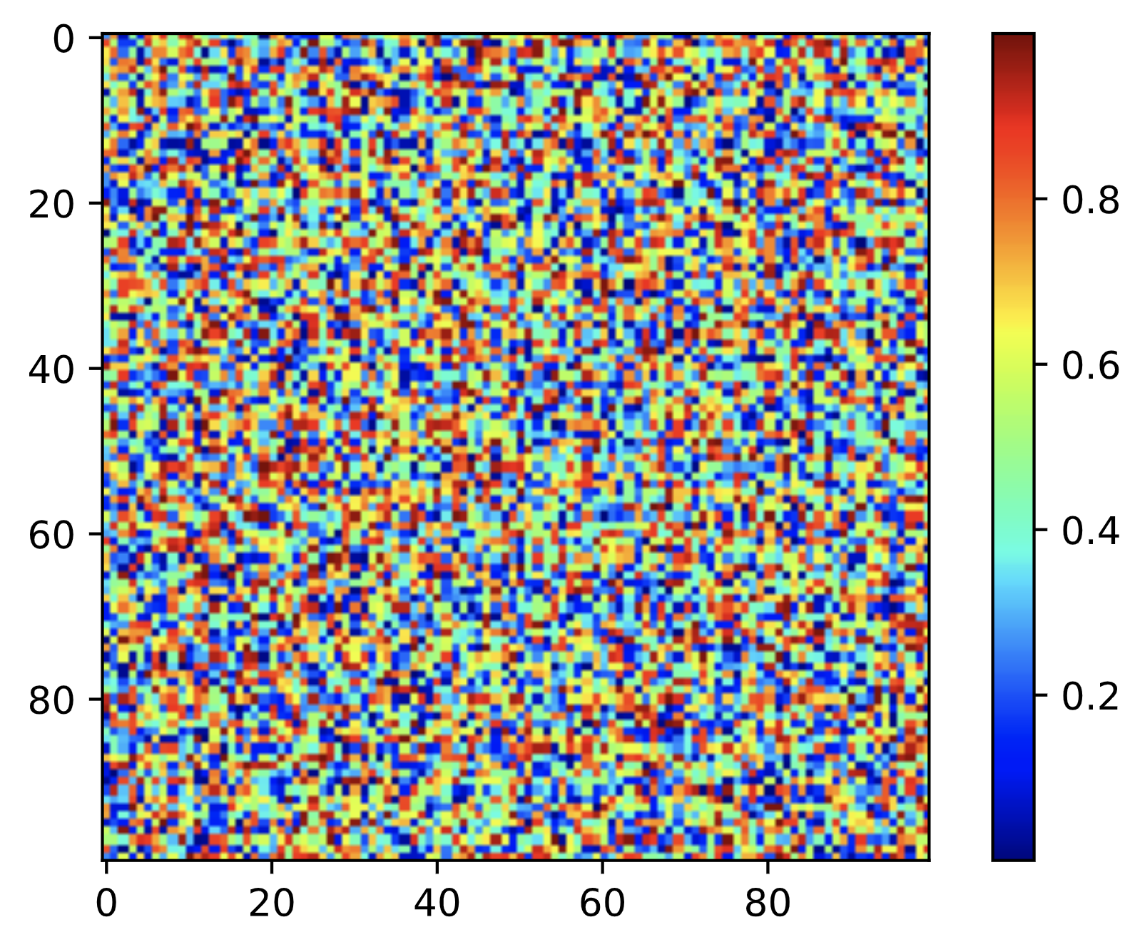
创建NDArray
按如下标准创建NDArray
形状(shape), e.g. 3 x 4
元素值, e.g 全部为0, 或者随机值
正态分布
均匀分布
100 x100 矩阵

Slide 5
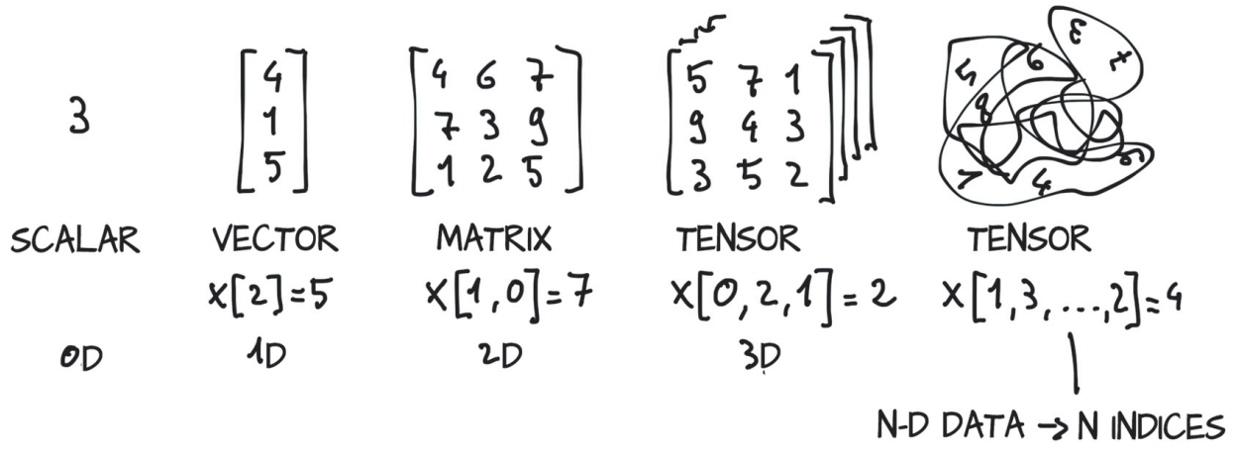
元素索引

Slide 6
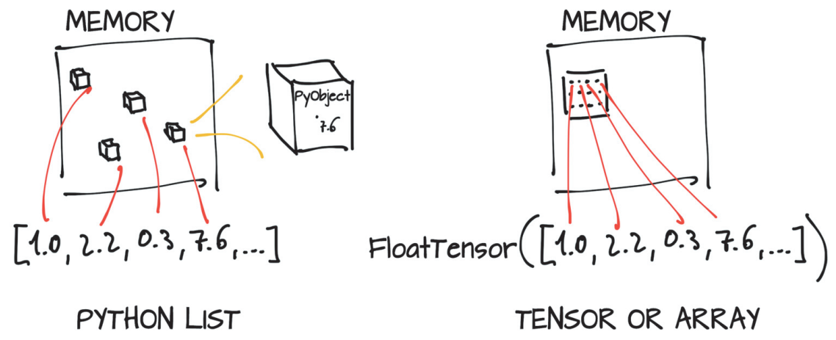
NDArray的存储
Notes:
Although on the surface, this example doesn’t differ much from a list of number objects, under the hood, things are completely different. Python lists or tuples of numbers are collections of Python objects that are individually allocated in memory, as shown on the left side of figure 2.3. PyTorch tensors or NumPy arrays, on the other hand, are views over (typically) contiguous memory blocks containing unboxed C numeric types, not Python objects.

